Slide 1

ERP System for Shanel Products
Project Proposal
Course Code and Name: ICT3183 – Group Project
Group Project ID and Group Name: G9 – Bizcore
Supervisor Name:
Date: January 29, 2026
Group members
TG/1356 - J.M.P.N.Jayaweera
TG/1379 - H.P.J.Jayarathna
TG/1410 - G.M.P.K.Premachandra
TG/1383 - A.L.S.Chamika

Slide 2

CLIENT OVERVIEW
Introduction to Shanel Products
Client Details :
Name - R.A.B.Erandi Wansapala
Business Name - Shanel Products
Address - Udawela,Morahela,Balangoda
Register Number - ර/ඉඹු/001924
Contact number - 0773174234
Our client, owns and operates Shanel Products, a thriving wholesale business specializing in both in-house manufactured goods and supplier products.
Current Operations:
Fully manual processes for all operations.
Separate inventory for production and sales stock.
Serves both retail and wholesale customer segments.
Employs 22 staff members, including managers and sales personnel.

Slide 3
Client Needs:
Managing sales
Inventory management
Production management
Employee attendance management
Employee payroll calculation
Real time notifications
Managing customers
Managing supplier
Financial and Account handling
Barcode reader and fingerprint integration

Slide 4
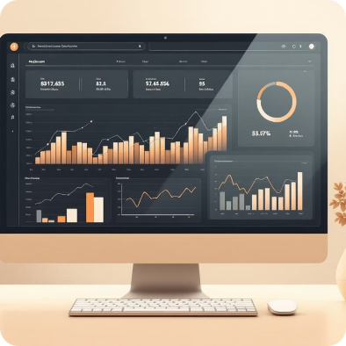


Introducing the Shanel ERP System
Proposed ERP System
Core Purpose
Business Support
To enhance operational efficiency, reduce manual errors, and provide real-time insights across sales, inventory, finance and human resources.
Empowering Shanel Products with automated workflows and data-driven decision-making for sustainable growth.
A robust Enterprise Resource Planning (ERP) system designed to streamline and integrate all core business processes at Shanel Products.

Slide 5

Addressing Current Operational issues
Current Manual Processes:
Shanel Products currently relies on entirely manual operations, leading to significant inefficiencies and potential for human error. This includes:
Handwritten sales orders and invoices.
Tracking inventory manually through books .
Manual payroll calculations and attendance logs.
Lack of centralized reporting and data analysis.
Inefficient management of supplier and customer records.
Difficulties in identifying low stocks ,expired products and raw materials .
Difficult to analyze financial data of the business properly.

Slide 6
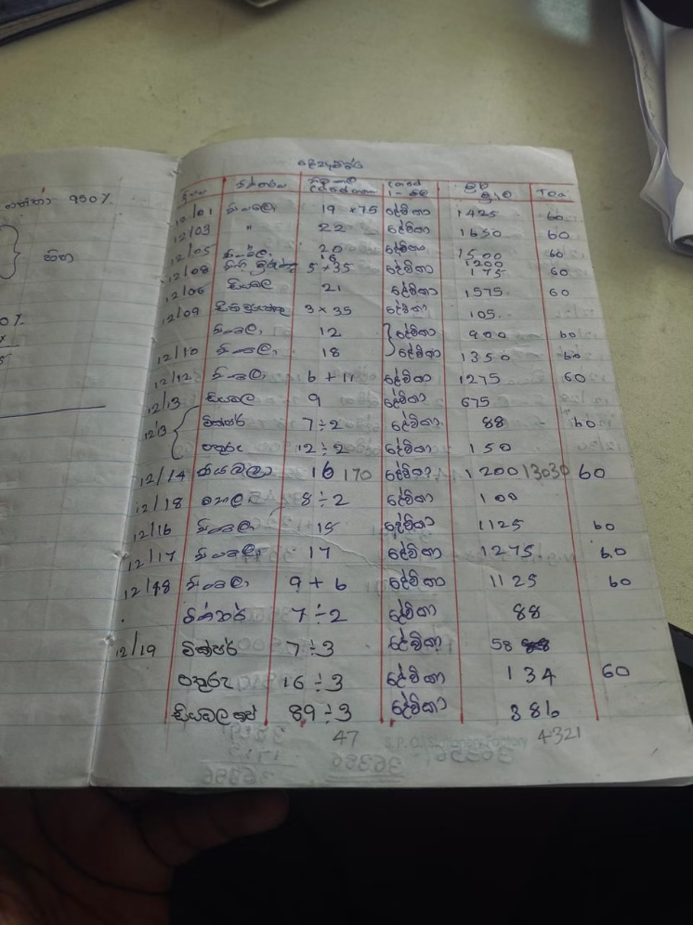
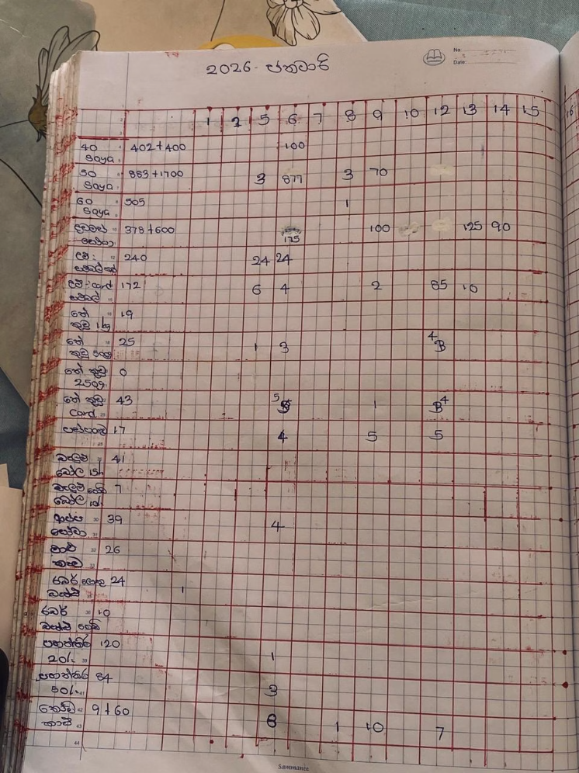
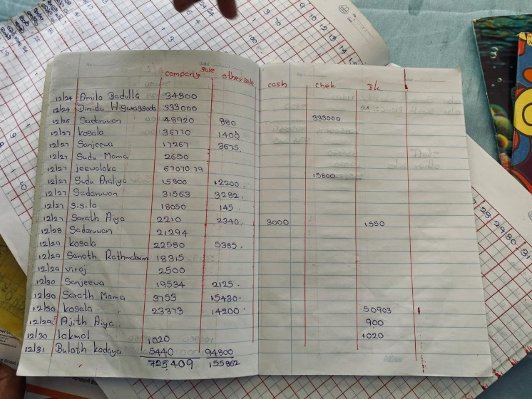
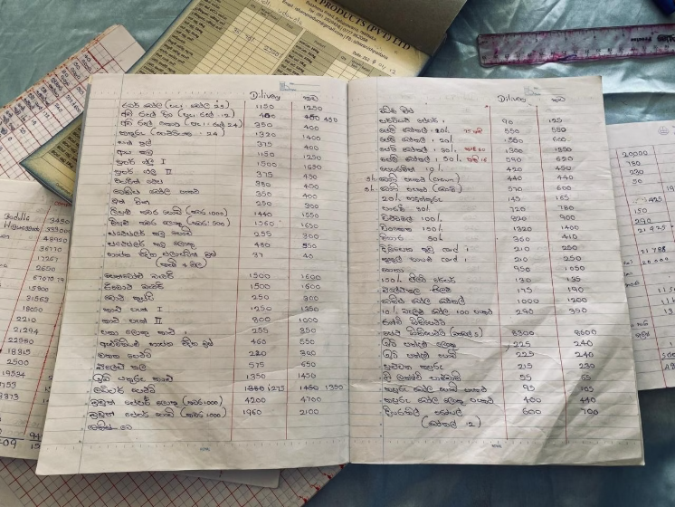
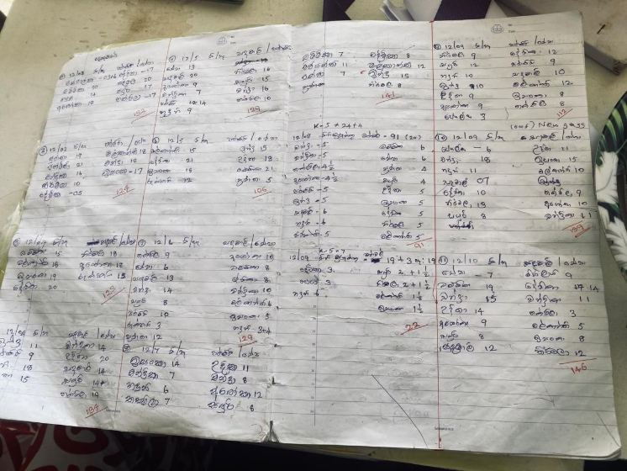
Challenges Faced:
Sale book
Price list book
Attendance book
Stock record book
Production record book

Slide 7

Aim and Key Objectives
Our primary aim is to implement a comprehensive ERP system that fully automates Shanel Products' operations.
Optimize Sales Processes
Streamline Inventory
Enhance HR & Payroll
Automate order entry, invoicing, and sales reporting for faster and more accurate transactions.
Implement real-time inventory tracking, ensuring optimal stock levels and reducing waste.
Automate employee attendance, leave management, and accurate payroll calculations.
Improve Reporting
Financial and account management
Provide comprehensive, real-time business insights through dynamic dashboards and reports.
To record and manage all financial transactions of the company such as sales, purchases and expences.

Slide 8

Defining the Project Boundaries
In-Scope Features:
Sales Management: invoicing, sales tracking,.
Managing customers : Customer data, interaction logs.
Inventory Management: Real-time tracking, stock alerts, barcode scanning.
Managing suppliers: Supplier data, purchasing.
Employee Management: Attendance, leave, fingerprint integration.
Payroll Calculation: Automated salary processing.
Real-time Notifications: Alerts for key events.
Advanced Financial Accounting (GL, AP, AR): Focus is on operational ERP.
Business Intelligence (Advanced BI): Basic reporting included, not deep analytics.
Out-of-Scope Features:
Sales Management: Order processing.
E-commerce Platform Integration: Not part of initial phase.

Slide 9

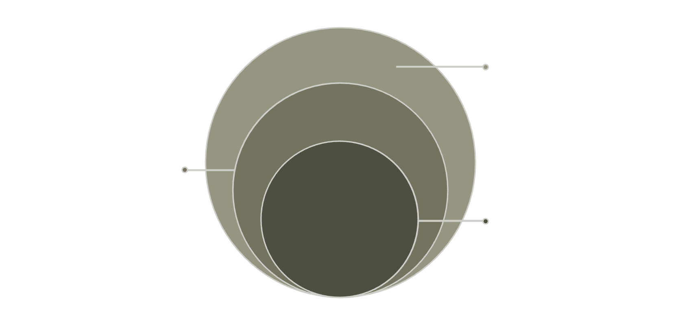
Methodology and Architecture
Database Layer
Persistent storage, backups, and optimized queries
Application Layer
Business logic, microservices, and integration workflows
Presentation Layer
User interface, responsive front-end, and API gateway
Development Methodology:
ERP System Architecture (High-Level):
We will adopt an Agile development approach, emphasizing iterative development, collaboration, and continuous feedback to ensure flexibility and client satisfaction.
Presentation Layer: User interface (Web/Mobile).
Application Layer: Business logic, API endpoints.
Data Layer: Database management, data storage.
Phases: Planning, Design, Development, Testing, Deployment.
Tools & Technologies: React.js for frontend, Node.js with Express.js/python for backend ,MySQL for database.

Slide 10
USERS
Empowering Shanel Products' Workforce
The proposed ERP system is meticulously designed to cater to the specific needs of Shanel Products' primary users.
Business Owner (Bhagya)
Manager
Sellers
Gain comprehensive, real-time insights into overall business performance, enabling strategic decision-making and growth planning.
Efficiently oversee daily operations, manage teams, track inventory, and monitor sales performance with integrated tools.
Streamline sales order processing, access real-time stock availability, and improve customer interaction through a user-friendly interface.

Slide 11
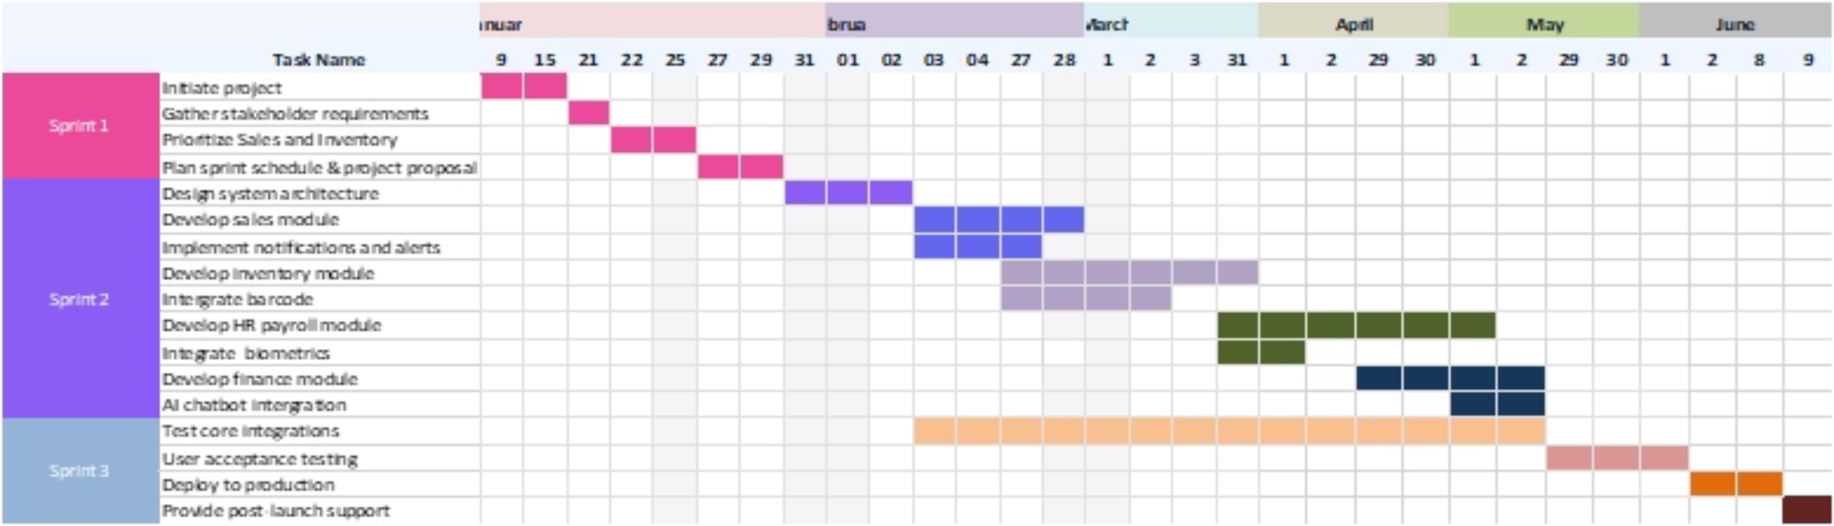
Project Timeline

Slide 12
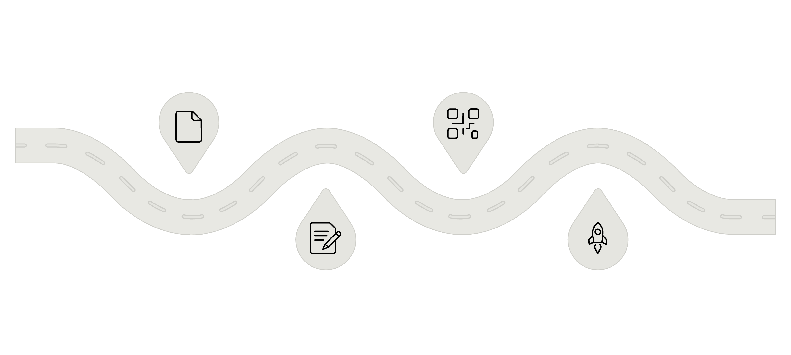
Key Milestones
Requirements
Development
Week 1–4: gather and finalize needs
Week 9–18: build core modules
Design
Testing & Deployment
Week 5–8: architecture and approvals
Week 19–24: UAT then production go‑live
Total Duration: 24 weeks (6 months)

Slide 13
Project Budget and Cost Justification
Development
100,000
Deployment
5000
Maintenance (1st Year)
5000
Total Estimated Project Cost: 110,000

Slide 14




Identifying and Mitigating Project Risks
Implementing a new ERP system involves inherent risks across technical, operational, and data security domains.
Proactive identification and mitigation are crucial for project success and long-term system stability.
Technical Risks
Operational Risks
Data Security Risks
Difficulty integrating with existing manual processes
System performance and scalability issues
Compatibility problems with hardware (e.g., barcode scanners)
Resistance from users adapting to new workflows
Disruptions during data migration and system rollout
Insufficient staff training
Unauthorized access and data breaches
Data loss or corruption during migration or use
Non-compliance with data protection standards
Effective strategies are essential to manage these potential challenges.
Rigorous Testing
Comprehensive Training
Perform unit, integration, and user acceptance testing (UAT).
Provide hands-on training and ongoing user support.
Data Security & Backup
Phased Implementation
Use encryption, access controls, and regular backups.
Roll out the system in stages to reduce disruption and allow improvements.

Slide 15

Inventory & Supply Chain
Manage separate inventories for production and stores .
Managing supplier
Stock transfer system
Stock adjustment (handle damage, expiry, missing stocks)
Reorder level and alerts (avoid stock out problem)
Inventory report and dashboard (stocks, production, purchase, stock transfer, expiry, supply purchase)
Production plan
TG/2022/1356
J.M.P.N.Jayaweera

Slide 16

Sales & Customer Management
Managing customers
Sales and billing (POS functionality)
Dual pricing system(retail/wholesale)
Credit sale and payment management
Sales report
Internal usage and monthly summary
TG/2022/1379
H.P.J.Jayarathna

Slide 17

Human Resources (HR) Management
Manage complete employee records within the system.
Recording and monitoring employee attendance on a daily and monthly basis.
Calculate employee salaries based on attendance and approve leaves.
Automate approving employee leaves.
Provide reporting features to support HR decision making .
Employee details report
Attendance summary report
Leave utilization report
Payroll summary report
TG/2022/1410
G.M.P.K.Premachandra

Slide 18

Finance & Accounting
Track and calculate revenue, expenses, gross profit, and net profit automatically.
Maintain a comprehensive ledger for all transactions, using double-entry accounting principles for balanced books.
Expense Categorization and Tracking
Generate financial reports such as P&L, balance sheet, and cash flow statements on-demand.
Provide reporting features to support HR decision making .
Create and track budget vs actual reports, forecast revenue, and monitor cash flow projections.
AI Chatbot for Real-Time Data-Driven Business Analysis
TG/2022/1383
A.L.S.Chamika

Slide 19
Effective Communication & Reporting Channels
Clear and consistent communication is essential for the success of the ERP project. Multiple communication channels will be used to keep all stakeholders informed and involved throughout the implementation.
Physical Meetings
Zoom Meetings
WhatsApp Group
Face-to-face meetings for detailed discussions, planning, and key decision-making.
Online meetings for remote collaboration, progress updates, and issue resolution.
Quick communication for urgent updates and daily coordination within the project team.
Regular reports on project progress, milestones, and budget will be shared through summary documents and presentations to ensure transparency and accountability.

Slide 20
Hardware & Software Specifications
To ensure optimal performance and seamless integration, the ERP system requires specific hardware and software configurations.
Hardware Requirements
Software Requirements
Development Machines: Intel Core i5+, 8GB RAM, 256GB SSD, dedicated/integrated graphics, 500GB storage.
Peripherals: Barcode scanners, fingerprint machines for efficient operations.
Servers: Intel Xeon equivalent+ with 16GB RAM or higher, configured for load balancing.
Network: High-speed internet connection for robust connectivity.
Security: Firewall implementation and hardware model-based security measures.
Operating Systems: Windows 11 for user machines, Windows Server for backend operations.
Development Tools: VSCode (IDE) and GitHub (Version Control).
Collaboration & Communication: ClickUp (Project Management), Zoom, Gmail, Outlook.
Frontend Technologies: HTML5, CSS3, Bootstrap, JavaScript.
Backend Technologies: Node.js with Express.js,python.
Database: MySQL for reliable data storage.

Slide 21
Robust Testing and Quality Assurance Framework
Ensuring the ERP system's reliability, performance, and security through comprehensive testing and quality assurance practices.
Testing Process
Unit Testing
Integration Testing
Verifying correctness of individual code units.
Validating interaction and compatibility between integrated components.
Tools: Jest (JavaScript), Pytest (Python)
Tools: Selenium (for end-to-end flows)
User Acceptance Testing (UAT)
System Testing
Ensuring the system meets user expectations and requirements.
Evaluating the entire system against specified requirements.
Tools: Manual testing by users, automated scripts
Tools: Project-specific testing frameworks
Quality Assurance Initiatives
Code Review
Continuous Integration
Peer review of code to identify defects and improve quality.
Automating build and test processes for frequent updates.
Tools: GitHub, Bitbucket, GitLab
Tools: Jenkins, Travis CI, GitHub Actions
Performance Testing
Security Testing
Assessing system responsiveness and stability under load.
Identifying vulnerabilities and ensuring data protection.
Tools: Apache JMeter, Gatling
Tools: OWASP ZAP

Slide 22
CONCLUSION
The implementation of the Shanel ERP system represents a transformative investment in operational excellence. By automating sales, inventory, HR, and supply chain management, Shanel Products will achieve:
Streamlined operations and reduced manual errors
Real-time visibility across all business functions
Improved decision-making through comprehensive reporting
Enhanced employee productivity and customer satisfaction
Sustainable growth and competitive advantage
This comprehensive project plan—covering vision, scope, methodology, timeline, and risk management—provides a clear roadmap for successful implementation. With proper execution and stakeholder commitment, the ERP system will position Shanel Products for long-term success and market leadership.

Slide 23


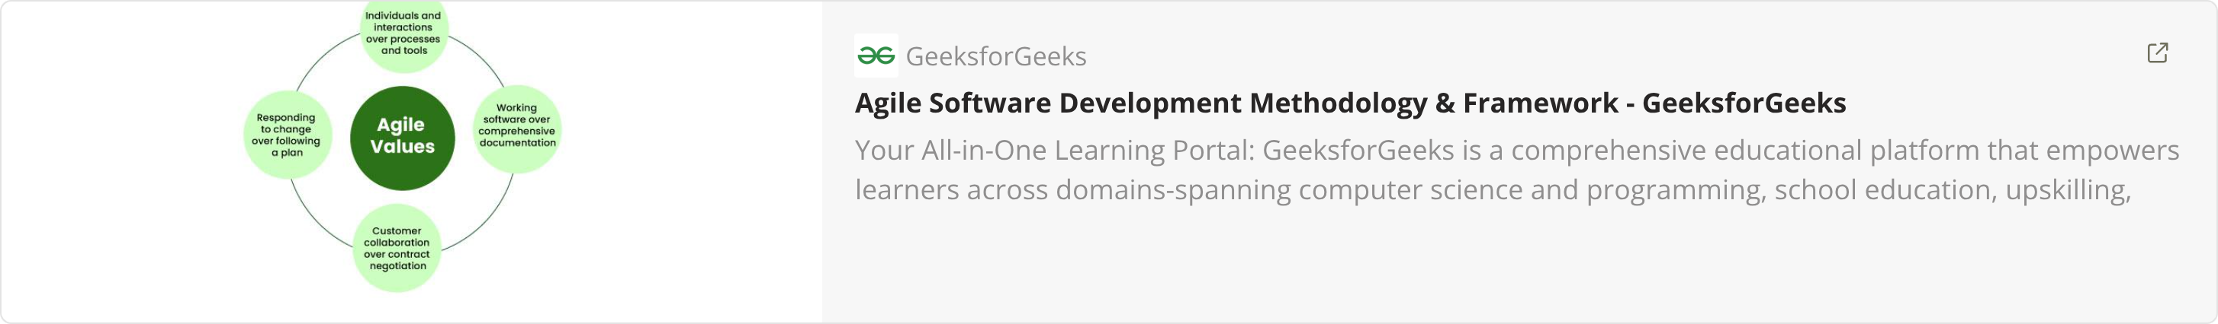
REFERENCES
ERP System Best Practices and Industry Standards
Project Management Institute (PMI) Guidelines for Implementation
Agile Development Methodology Framework

Slide 24
Thank You!

